Slide 1
SQL Project
On IPL Auction
By
Rahul Das

Slide 2
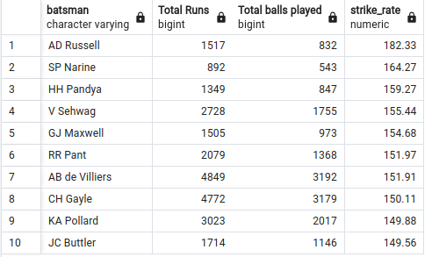
Top 10 batter with most strike rate
Query :
select distinct batsman, sum(batsman_runs) as "Total Runs", count(ball) as "Total balls played",
round((cast(sum(batsman_runs)as decimal)/cast(count(ball)as decimal)*100),2) as strike_rate from ipl_ball
where extras_type !='wides'
group by batsman
having count(ball)>500
order by strike_rate desc
limit 10;
Result :

Slide 3
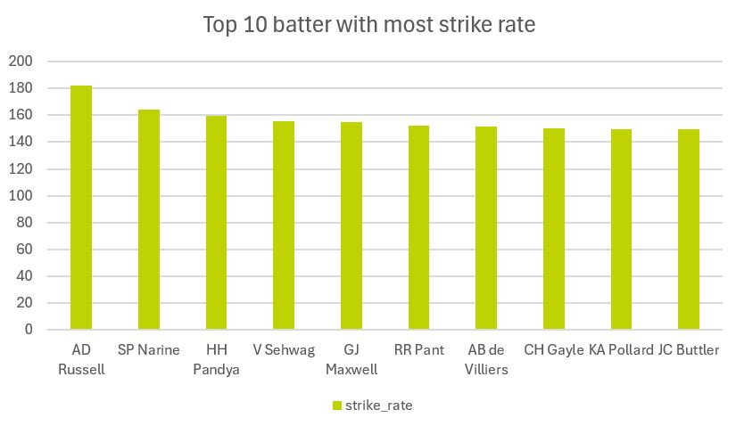

Slide 4
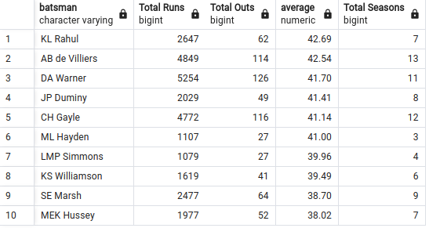
Top 10 batter with most average
Query :
select distinct a.batsman , sum(a.batsman_runs) as "Total Runs",
sum(a.is_wicket) as "Total Outs",
round((sum(a.batsman_runs)::decimal/sum(a.is_wicket)),2) as average,
count(distinct(extract(year from b.date))) as "Total Seasons"
from ipl_ball as a left join ipl_matches as b on a.id=b.id
group by a.batsman
having count(distinct(extract(year from b.date)))>2 and
sum(a.batsman_runs)>1000 -- as scoring run is also important for an anchor so I added this condition
order by average desc
limit 10;
Result :

Slide 5
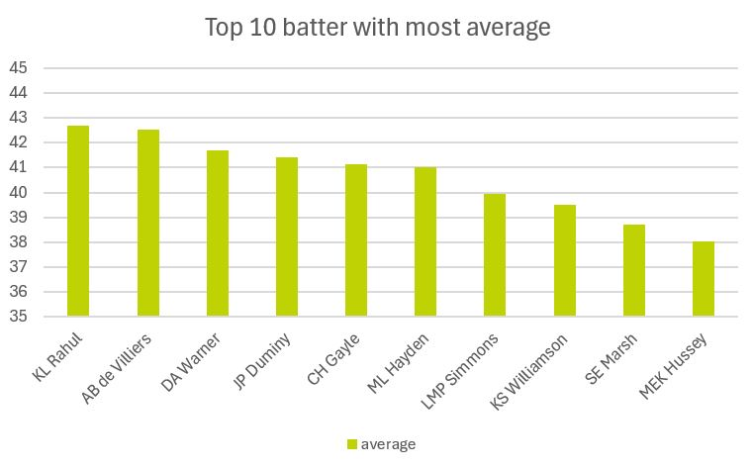

Slide 6
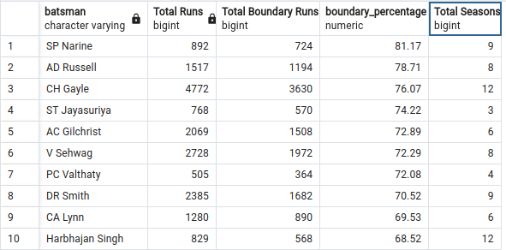
Top 10 batter with most boundary percentage
Query:
select a.batsman,sum(a.batsman_runs) as "Total Runs",
sum(case when a.batsman_runs in (4, 6) then a.batsman_runs else 0 end) as "Total Boundary Runs",
round((sum(case when a.batsman_runs in (4, 6) then a.batsman_runs else 0 end)::decimal /sum(a.batsman_runs)*100,2) as boundary_percentage,
count(distinct(extract(year from b.date))) as "Total Seasons"
from ipl_ball as a left join ipl_matches as b on a.id=b.id
group by a.batsman
having count(distinct(extract(year from b.date)))>2 and
sum(a.batsman_runs)>400 -- again to give the data more credibility
order by boundary_percentage desc
limit 10;
Result :

Slide 7
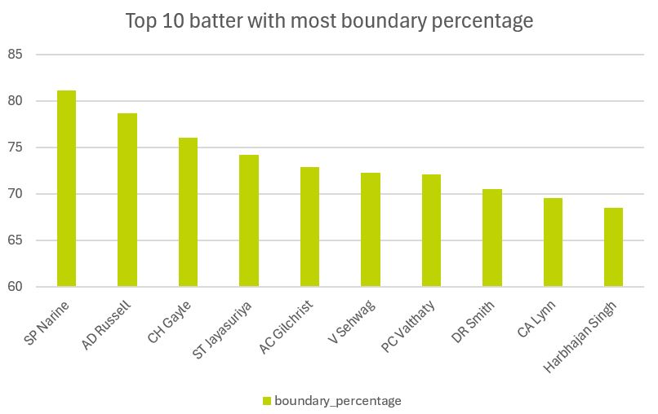

Slide 8
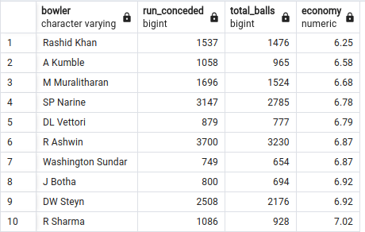
Top 10 best economical bowler
Query:
select a.*,round(a.run_conceded::decimal/a.total_balls*6,2)as economy from (select bowler,
sum(case when extras_type not in('byes','legbyes') then total_runs else 0 end) as run_conceded,
count(case when extras_type not in('wides','noballs') then ball end) as total_balls
from ipl_ball
group by bowler
) as a
where a.total_balls>500
order by economy
limit 10;
Result :

Slide 9
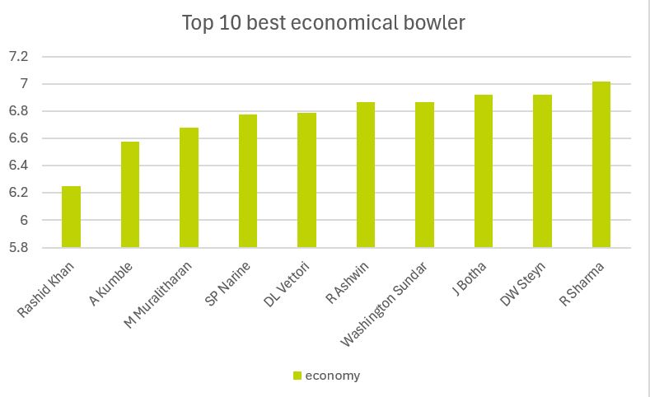

Slide 10
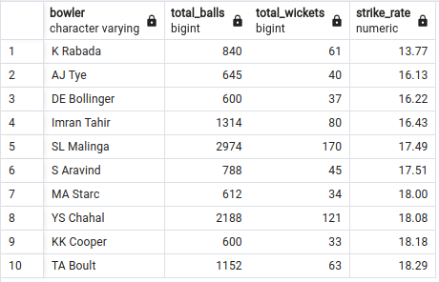
Top 10 bowler with best strike rate
Query:
select a.*,
round(a.total_balls::decimal/a.total_wickets,2) as strike_rate
from (
select bowler, count(ball) as total_balls,
sum(case when dismissal_kind not in('obstructing the field','retired hurt','run out') then is_wicket else 0 end) as total_wickets
from ipl_ball
group by bowler
) as a
where a.total_wickets!=0 and a.total_balls>500
order by strike_rate
limit 10;
Result:

Slide 11
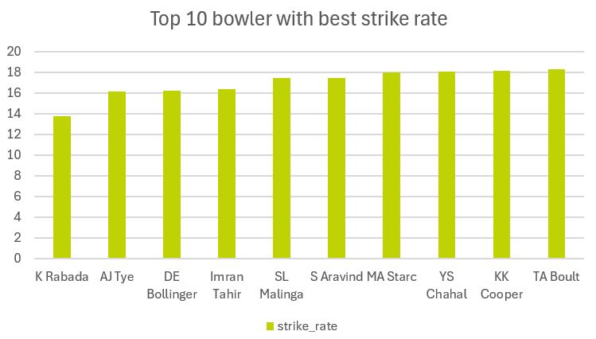

Slide 12
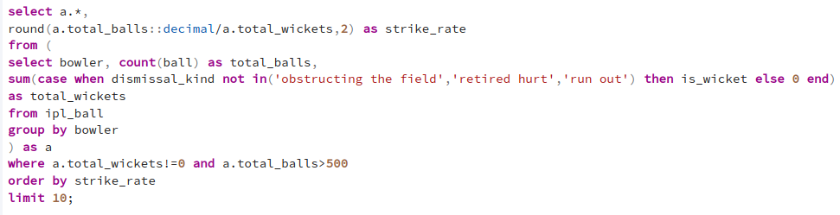
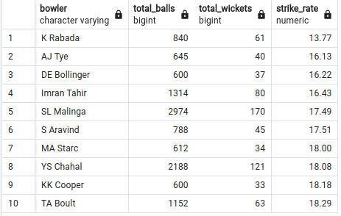
Top 10 all rounders
Query :
Result:

Slide 13
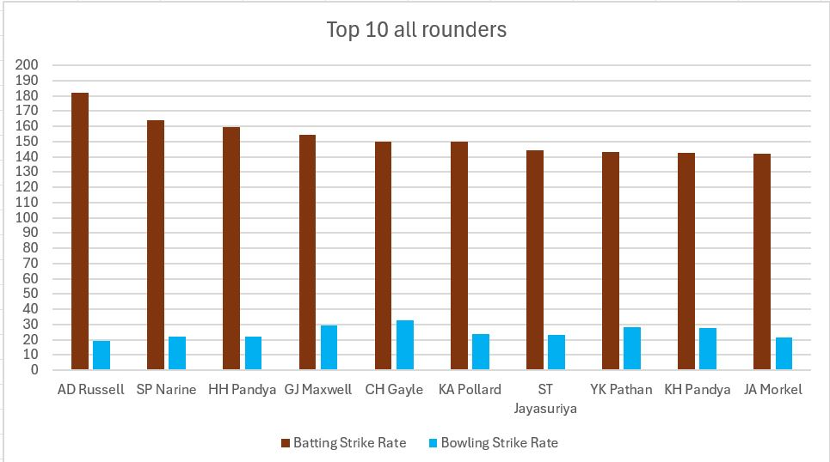

Slide 14
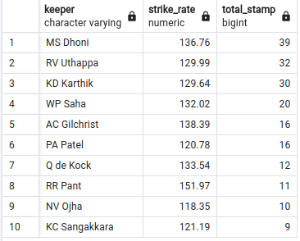
Top 10 best wicket keeper
Query:
select a.batsman as keeper,a.strike_rate, b.total_stamp
from
(select distinct batsman, sum(batsman_runs) as "Total Runs", count(ball) as "Total balls played",
round((cast(sum(batsman_runs)as decimal)/cast(count(ball)as decimal)*100),2) as strike_rate from ipl_ball
where extras_type !='wides'
group by batsman) as a
join
(select fielder , sum(is_wicket) as total_stamp from ipl_ball
where dismissal_kind='stumped'
group by fielder) as b
on a.batsman=b.fielder
order by b.total_stamp desc ,a.strike_rate desc
limit 10;
Result:

Slide 15
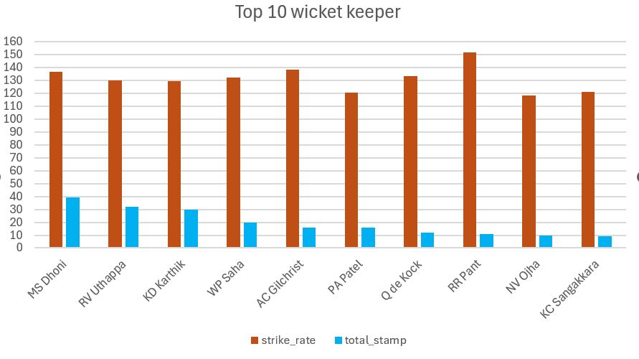

Slide 16

Additional Questions
1)Get the count of cities that have hosted an IPL match.
Query:
select count(distinct(city)) as total_cities from ipl_matches;
Result:

Slide 17
2) Create table deliveries_v02 with all the columns of the table ‘deliveries’ and an additional column
ball_result containing values boundary, dot or other depending on the total_run
(boundary for >= 4, dot for 0 and other for any other number) .
Query :
create table deliveries_v02 as
(select *,
(case when total_runs => 4 then 'boundary'
when total_runs = 0 then 'dot'
else 'other' end) as result
from ipl_ball);

Slide 18

3)Write a query to fetch the total number of boundaries and dot balls from the deliveries_v02 table.
Query:
select count(case when result='boundary' then result end) as total_boundary,
count(case when result='dot' then result end) as total_dots from deliveries_v02;
Result:

Slide 19
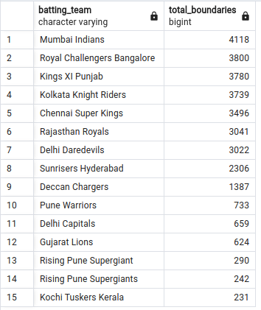
4)Write a query to fetch the total number of boundaries scored by each team from
the deliveries_v02 table and order it in descending order of the number of boundaries scored.
Query:
select batting_team,count(result) as total_boundaries
from deliveries_v02
where result='boundary'
group by batting_team
order by total_boundaries desc;
Result:

Slide 20
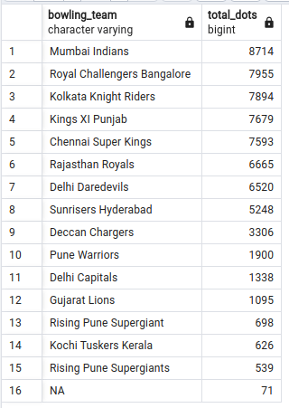
5) Write a query to fetch the total number of dot balls bowled by each team and order it in descending order of the total number of dot balls bowled.
Query:
select bowling_team,count(result) as total_dots
from deliveries_v02
where result='dot'
group by bowling_team
order by total_dots desc;
Result:

Slide 21
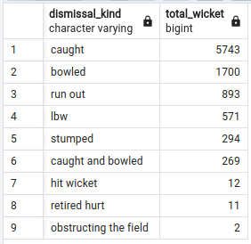
6) Write a query to fetch the total number of dismissals by dismissal kinds where dismissal kind is not NA.
Query:
select dismissal_kind,
count(dismissal_kind) as total_wicket
from deliveries_v02
where dismissal_kind !='NA'
group by dismissal_kind
order by total_wicket desc;
Result:

Slide 22
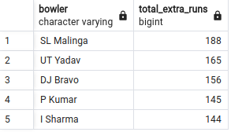
7)Write a query to get the top 5 bowlers who conceded maximum extra runs from the deliveries table.
Query:
select bowler, sum(total_runs) as total_extra_runs
from deliveries_v02
where extras_type in ('wides','noballs')
group by bowler
order by total_extra_runs desc
limit 5;
Result:

Slide 23
8)Write a query to create a table named deliveries_v03 with all the columns of deliveries_v02 table and two additional column (named venue and match_date) of venue and date from table matches.
Query:
create table deliveries_v03 as (
select a.*, b.venue as venue,b.date as date from deliveries_v02 as a join ipl_matches as b
on a.id=b.id);

Slide 24
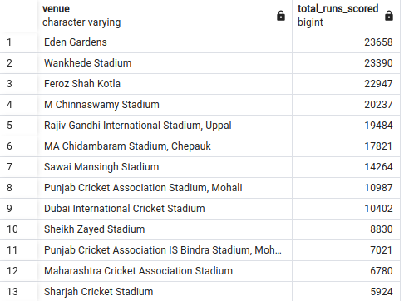
9)Write a query to fetch the total runs scored for each venue and order it in the descending order of total runs scored.
Query:
select venue,sum(total_runs) as total_runs_scored
from deliveries_v03
group by venue
order by total_runs_scored desc;
Result:

Slide 25
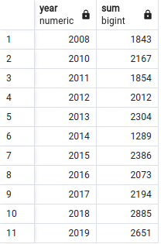
10)Write a query to fetch the year-wise total runs scored at Eden Gardens and order it in the descending order of total runs scored.
Query:
select extract(year from date)as year,sum(total_runs)
from deliveries_v03
where venue= 'Eden Gardens'
group by year;
Result:

Slide 26
THE
END

